Slide 1

Design and Analysis of a Low-Power Conditional-Capture Flip-Flop (CCFF)
32 nm CMOS Digital Integrated Circuits
COURSE
ENCS333 – Digital Integrated Circuits
TOOLCHAIN
Team Members
Electric VLSI + SPICE
Abedalrheem Fialah - 1220216
Aws Hammad - 1221697
Ibraheem Sleet - 1220200
INSTRUCTOR
Khader Mohammad

Slide 2
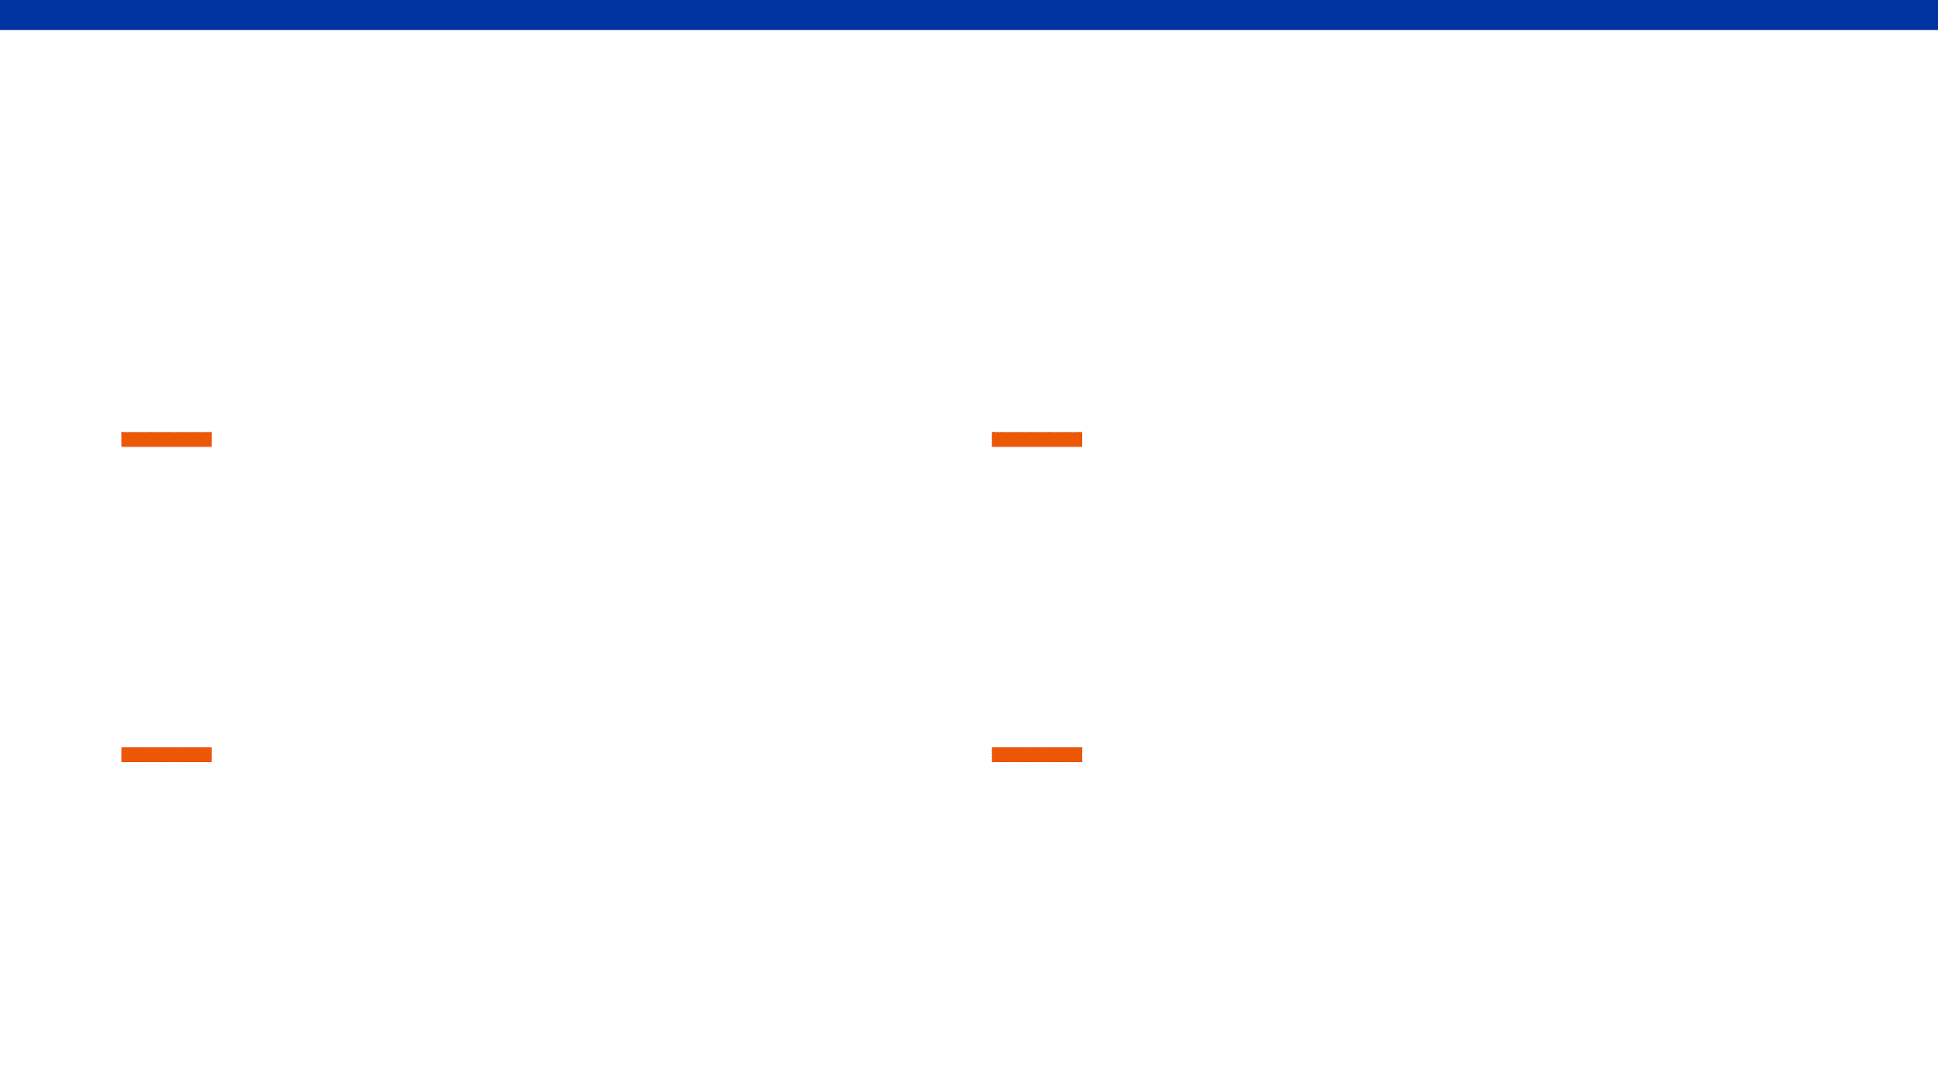
Clocked Storage Elements Dominate Total Chip Power
The Power Bottleneck
Redundant Activity
Flip-flops and clock distribution networks contribute 30–50% of total clock power in modern high-performance integrated circuits.
Conventional flip-flops switch internal nodes every clock cycle, even when the input data (D) matches the stored state (Q), leading to wasted dynamic power.
Dynamic Power Waste
Our Design Goal
Every clock transition triggers internal charging and discharging cycles, regardless of the actual data activity levels in the circuit.
To implement a mechanism that reduces clock and internal power by disabling capture when data remains unchanged, without compromising timing integrity.

Slide 3

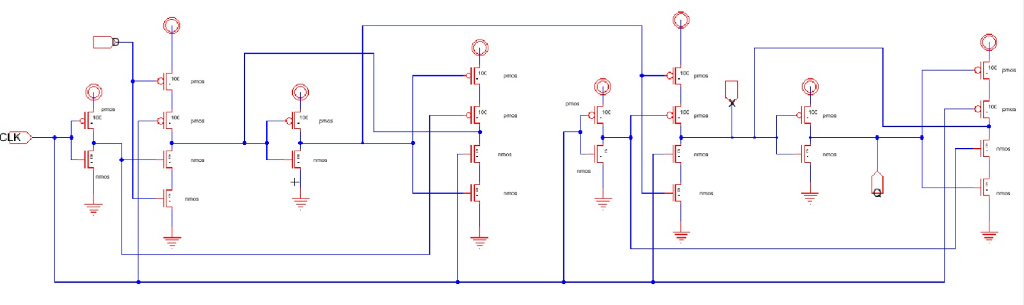
Master-Slave Flip-Flops Exhibit High Switching Overhead
Master-Slave Structure
Precharge Inefficiency
Typical designs use two cascaded latches controlled by complementary clock signals, doubling the internal switching activity.
Internal nodes precharge and discharge every clock cycle, creating a high clock load and wasting energy on redundant transitions.
Data Independence
Scaling Challenges
Power consumption remains high even during periods of zero data activity (D=Q), making it inefficient for low-switching workloads.
As technology scales to 32 nm, leakage and dynamic power become critical constraints that standard designs struggle to address.
Conventional Master-Slave FF Schematic

Slide 4

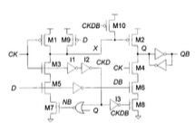
Conditional-Capture Concept Enables Data-Dependent Power Gating
Intelligent Capture Logic
The CCFF employs a comparator to check if D ≠ Q. Internal switching only occurs when a state change is required.
Statistical Efficiency
Conditional capture flip-flop (single-ended)
By disabling capture when D = Q, redundant transitions are eliminated, significantly reducing average dynamic power.

Slide 5

CCFF Architecture Integrates Control Logic for Efficient Switching
Stage 01
Stage 02
Conditional Capture
Storage Element
An input stage that compares D and Q and asserts an internal enable only when a change is needed.
A compact latch that holds state with minimal leakage and high stability in 32 nm CMOS.
Mechanism
Internal Clock Gating & Timing Integrity
Logic compares input and output so the clock reaches the storage only when the data will change, saving power while keeping timing margins.

Slide 6
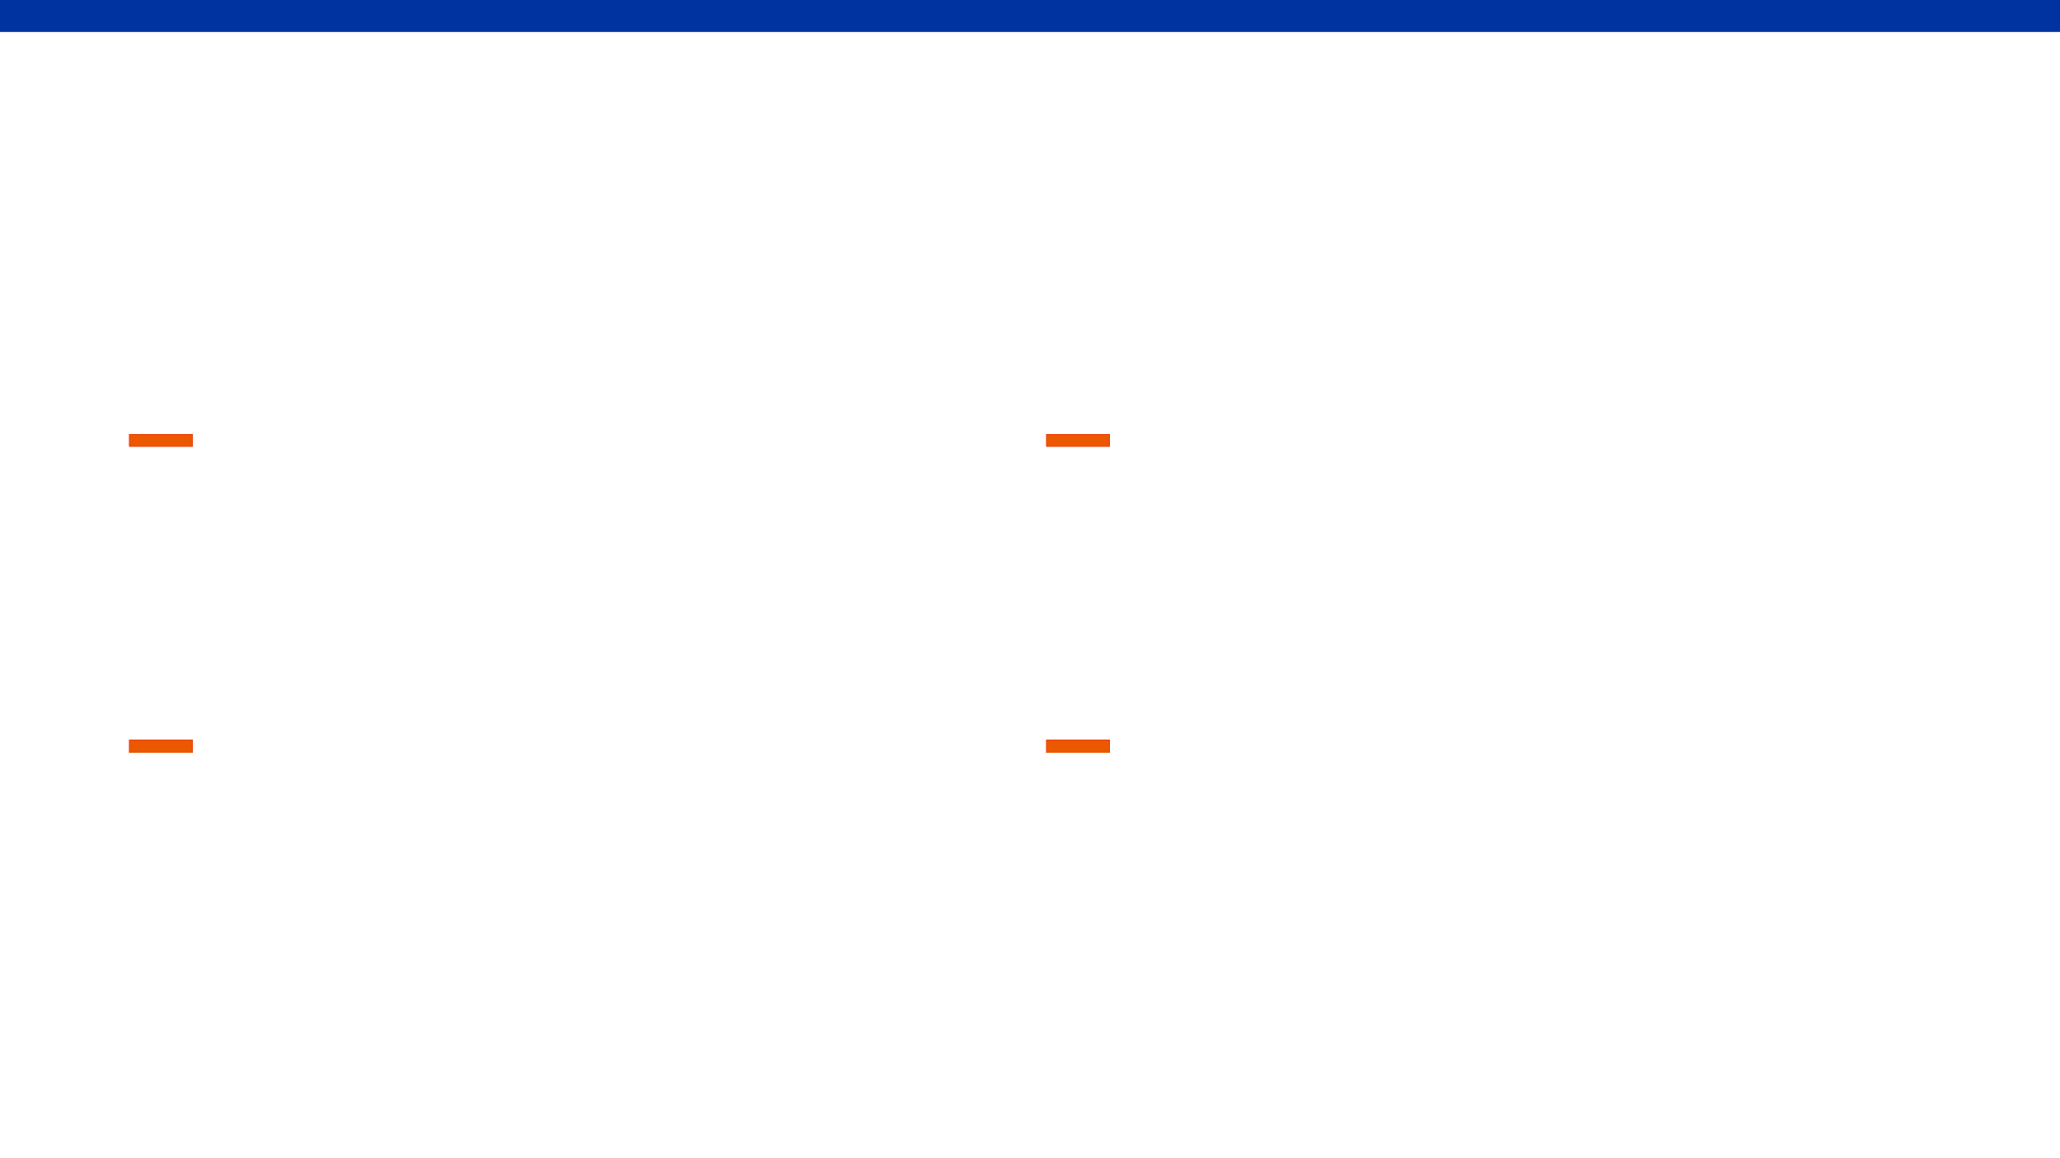
Schematic Design Focuses on Minimizing Clocked Capacitance
Transistor-Level Design
Path Optimization
The CCFF is implemented using a full-custom approach in 32 nm CMOS, optimizing transistor sizing for the conditional capture path.
The conditional path is specifically engineered to disable evaluation nodes when D equals Q, preventing unnecessary switching.
Capacitive Loading
Voltage Scaling
By reducing the number of transistors directly connected to the clock network, we significantly lower the total clocked capacitance.
The design is optimized for standard VDD operation, ensuring reliable performance across various process corners and temperatures.
Technology
Toolchain
Simulation
32 nm CMOS
Electric VLSI
SPICE Engine

Slide 7
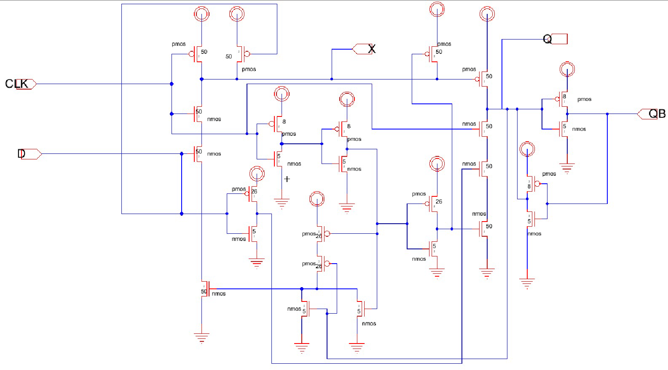
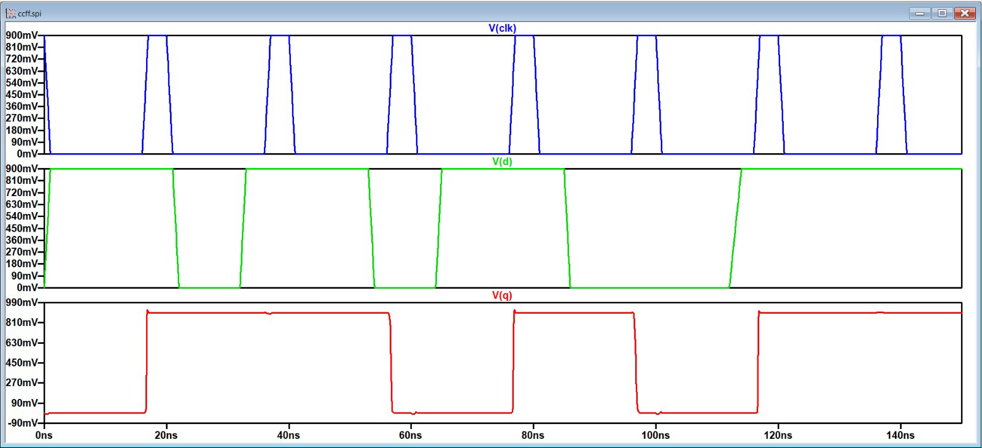
Pre-Layout Simulation Verifies Functional Correctness
Transient Analysis
Verified correct data capture across various input patterns and clock frequencies in the 32 nm CMOS process.
Conditional capture flip-flop Pre-Layout
Zero-Switching Validation
Confirmed that internal nodes remain static when D = Q, effectively eliminating redundant power consumption.
Performance Metrics
Measured Clk-to-Q delay and setup/hold times to ensure high-speed operation and timing margin.
Conditional capture flip-flop Pre-Layout Simulation

Slide 8

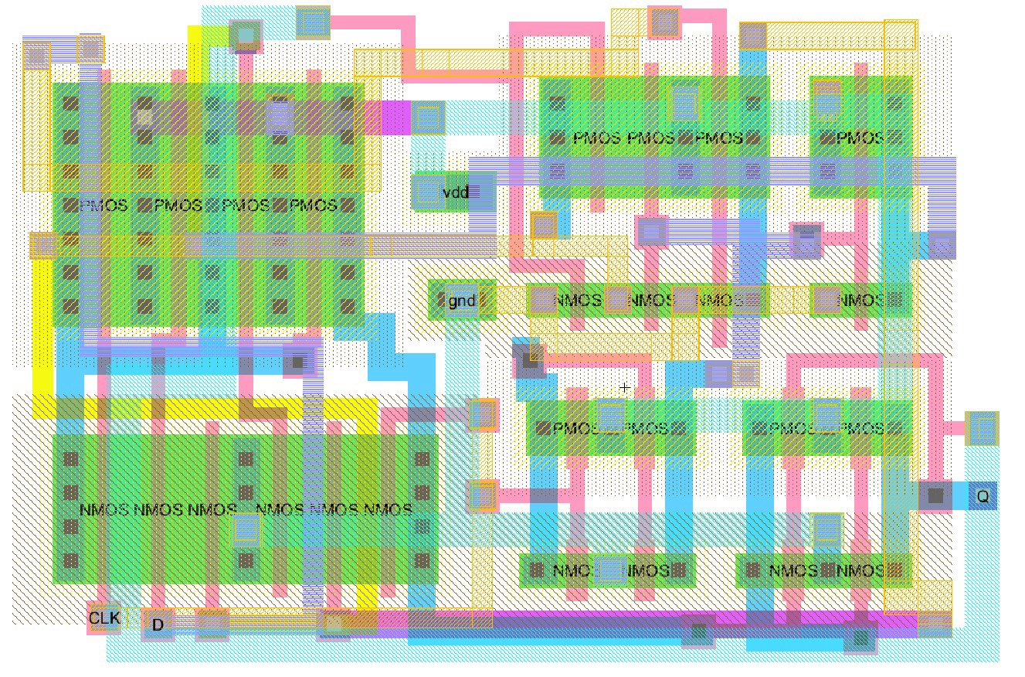
Full-Custom Layout Optimizes Area and Interconnect Parasitics
Compact Placement
Shared diffusion and careful sizing minimize cell footprint in 32 nm.
Area Optimization
Compact routing balances control logic to keep PDA competitive.
Parasitic Management
Conditional capture flip-flop Post-Layout
Selective metal usage reduces interconnect capacitance and power impact.

Slide 9

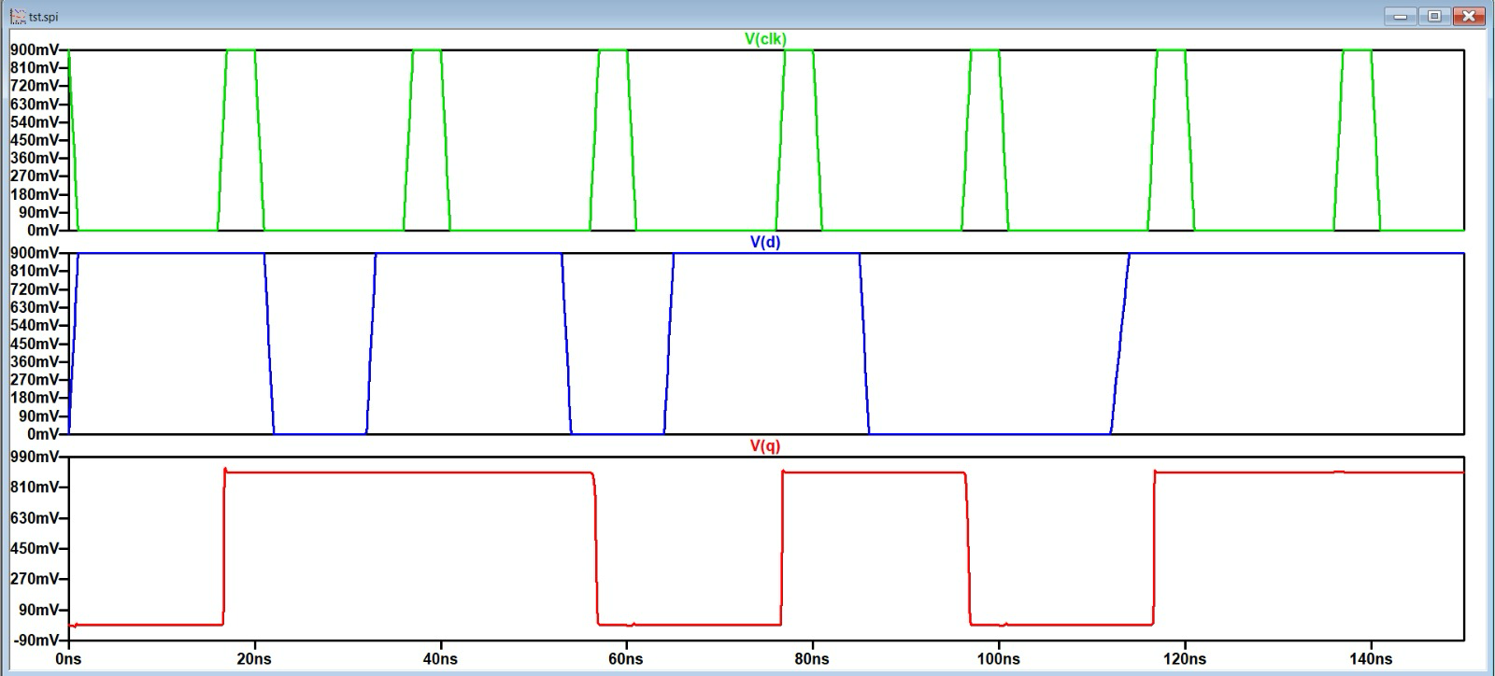
Post-Layout Simulation Accounts for Parasitic Effects
Parasitic Extraction
Performed full extraction to include interconnect capacitance and diffusion parasitics, ensuring a realistic performance assessment.
Robustness Verification
Verified that the CCFF maintains its power-saving advantages and functional stability even with layout-induced overhead.
Conditional capture flip-flop Post-Layout Simulation
Delay & Stability
Analyzed the impact of parasitics on Clk-to-Q delay, confirming stable operation under varying load conditions.

Slide 10

CCFF Achieves Significant Power Reduction Over Standard Designs
Power Efficiency
Activity Scaling
Clock Power Reduction
Dynamic Power Savings
Lower clock dynamic power from reduced capacitive loading.
Greater savings at lower activity for low-activity paths.
Physical Design
Timing Stability
Area Trade-off
Performance Balance
Minor area overhead due to gating and comparison for conditional capture.
Timing remains within limits for 32 nm, ensuring robust operation.
Optimized for 32 nm CMOS: Power ↓ | Timing OK | Area Reasonable

Slide 11
Comprehensive Metrics Ensure a Fair Design Comparison
Metric
Master-Slave FF
CCFF
Clk-to-Q Delay
4.05 x 10^-8
4.02 x 10^-8
Setup time
3.6 x 10^-8
3.6 x 10^-8
Hold time
1.7 x 10^-8
1.7 x 10^-8
Area
3.5 e^-12
3.86 e^-12
Avg Power
3.5 e^-12
3.5 e^-12
Comparison Framework: Both designs evaluated in 32 nm CMOS under identical VDD, temperature, and load conditions for a fair Power-Delay-Product (PDP) analysis.

Slide 12

CCFF is an Effective Solution for Low-Power Sequential Logic
Summary
Application
Redundant Switching Eliminated
Ideal for Low-Activity Paths
Implemented a CCFF that removes redundant switching, giving statistical power reduction.
Best for low temporal activity paths as a robust alternative to standard flip-flops.
Future Work
Verdict
Advanced Node Optimization
Ready for Integration
Optimize in 22 nm and beyond using FinFETs to reduce leakage and dynamic power.
A low-power solution balancing area, timing, and power for modern sequential designs.
Design Validated | Power Optimized | 32 nm CMOS Ready

